Slide 1
Object Oriented Programming Lab # 06 Understanding the Concept of Overloading
ENGR SANIYA SARIM

Slide 2
Method Overloading
Method Overloading is a feature that allows a class to have more than one method having the same name, if their argument lists are different.
It is similar to constructor overloading in Java, that allows a class to have more than one constructor having different argument lists.

Slide 3
Argument Lists
When I say argument list it means the parameters that a method has:
For example the argument list of a method add(int a, int b) having two parameters is different from the argument list of the method add(int a, int b, int c) having three parameters.

Slide 4

Three ways to Overload a Method
In order to overload a method, the argument lists of the methods must differ in either of these:
1. Number of parameters.
For example: This is a valid case of overloading

Slide 5
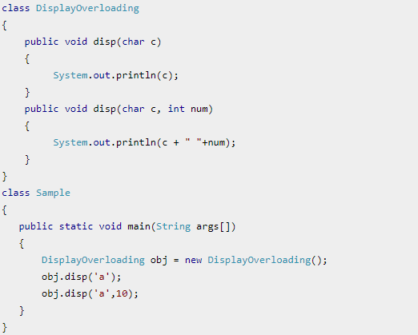
Example 1: Overloading – Different Number of parameters in argument list

Slide 6

Three ways to Overload a Method
2. Data type of parameters.
For example:

Slide 7
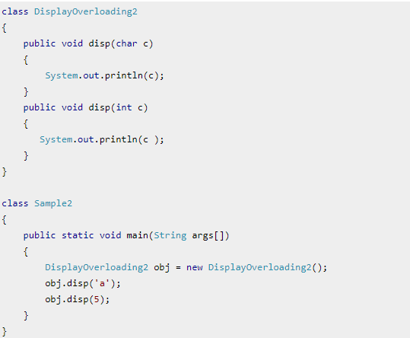
Example 2: Overloading – Difference in data type of parameters

Slide 8

Three ways to Overload a Method
3. Sequence of Data type of parameters.
For example:

Slide 9
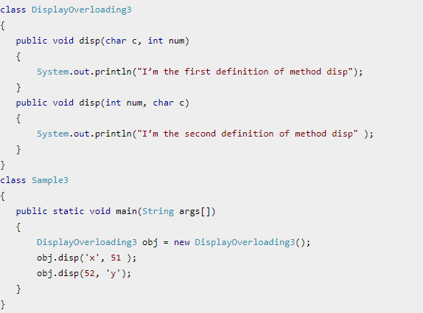
Example3: Overloading – Sequence of data type of arguments

Slide 10

Invalid case of method overloading:
When I say argument list, I am not talking about return type of the method, for example if two methods have same name, same parameters and have different return type, then this is not a valid method overloading example. This will throw compilation error.

Slide 11
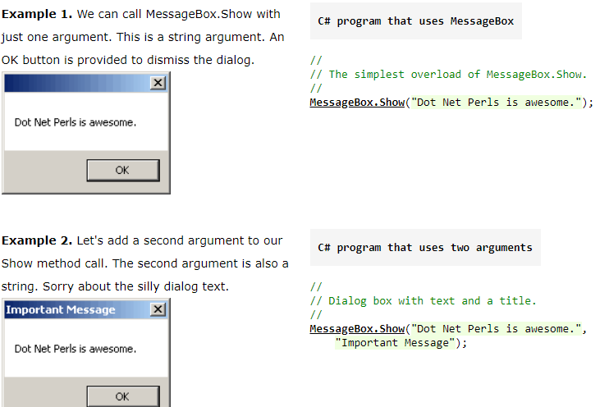
C# Messgebox.show Example of Overloading

Slide 12
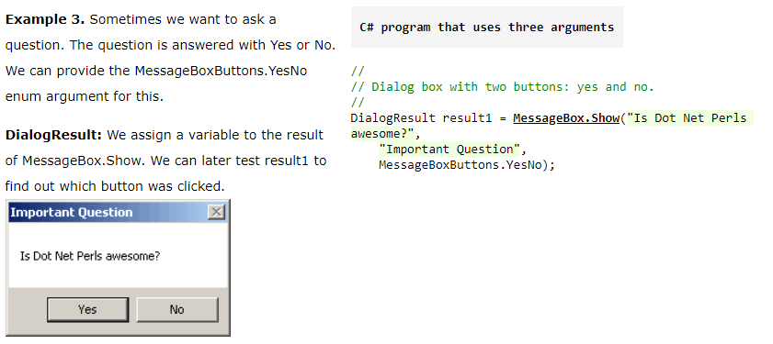
C# Messgebox.show Example of Overloading

Slide 13
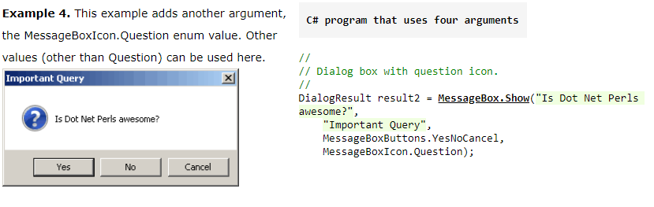
C# Messgebox.show Example of Overloading

Slide 14
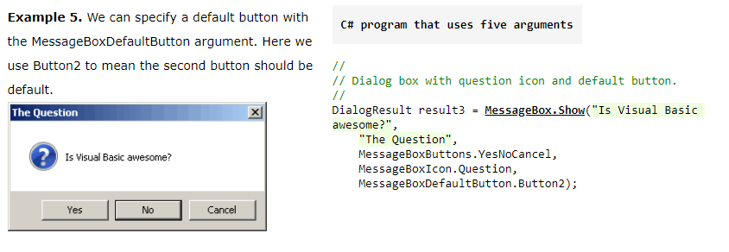
C# Messgebox.show Example of Overloading

Slide 15
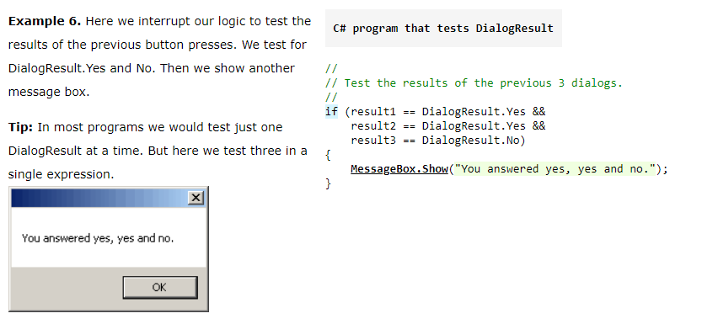
C# Messgebox.show Example of Overloading

Slide 16
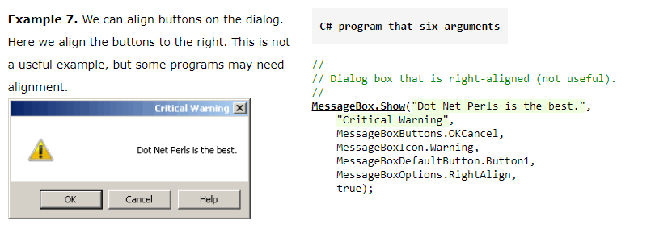
C# Messgebox.show Example of Overloading

Slide 17
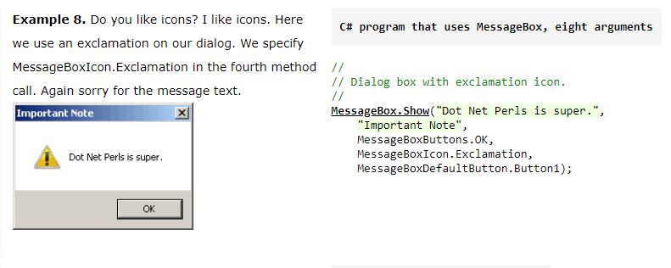
C# Messgebox.show Example of Overloading

Slide 18
Exercise 1
Write a java program consisting of two static methods
First method will add 2 integer numbers
Second method will add 3 integer numbers

Slide 19
Exercise 2
Write a Java program to display StudentID, Name and Grade using method overloading.
(Hint: Use two parameters in first method and 3 parameters in second method.)

Slide 20
Advantage of Method Overloading
The advantage of method overloading in Java is that it makes easier for us deal with methods as we don’t have to remember different names for the same operation, we can just change the parameters of a method.

Slide 21
Operator Overloading
The concept of overloading a function can also be applied to operators.
Operator overloading gives the ability to use the same operator to do various operations. It provides additional capabilities to C# operators when they are applied to user-defined data types.
It enables to make user-defined implementations of various operations where one or both of the operands are of a user-defined class.

Slide 22
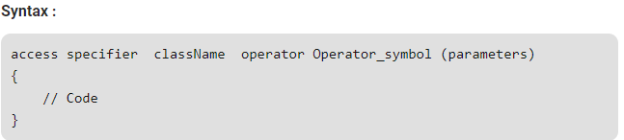
Syntax for Operator Overloading
To use operators with user-defined data types, they need to be overloaded according to a programmer’s requirement.
An operator can be overloaded by defining a function to it. The function of the operator is declared by using the operator keyword.

Slide 23
Opertor Overloading in JAVA
Java doesn't support user-defined operator overloading.
So, we will be using C# to perform operator overloading.

Slide 24
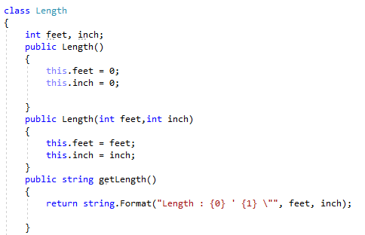
Example1: (Operator Overloading)

Slide 25
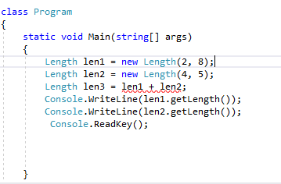
Example 1: Error ... Why?

Slide 26
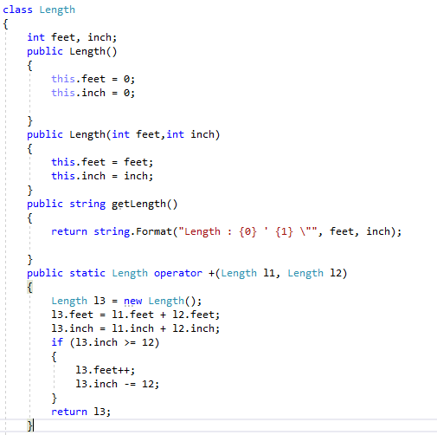
Example 1: Error resolved by Operator Overloading

Slide 27
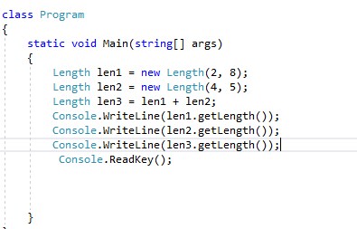
Example 1: Error resolved by Operator Overloading

Slide 28
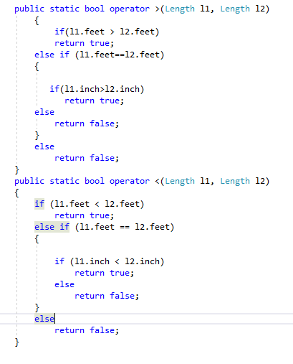
Operator Overloading (> and <)

Slide 29
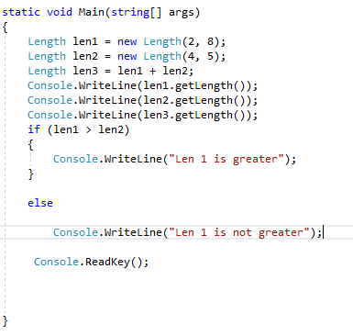
Operator Overloading (> and <)

Slide 30
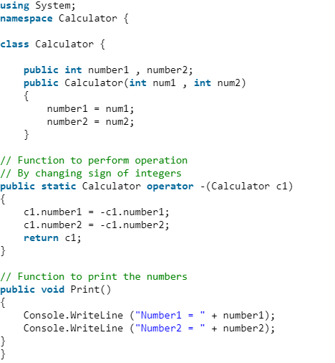
Example2(Unary Operator Overloading)

Slide 31
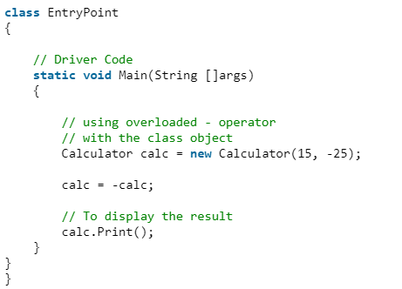
Example2 cont...

Slide 32
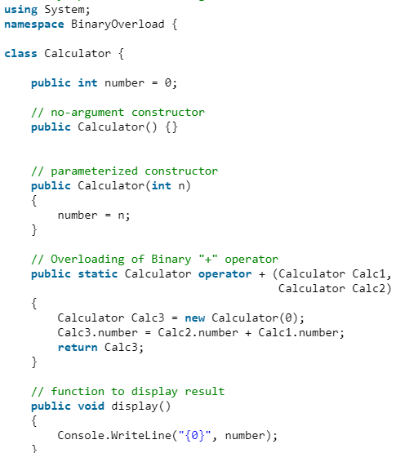
Example3(Binary Operator Overloading)

Slide 33
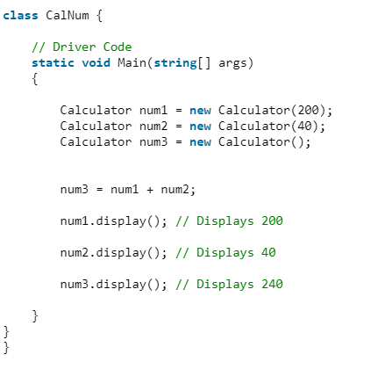
Example3 (BinaryOperator Overloading cont..)

